Slide 1
Tracing Fourier-Transform Methods in SARS-CoV-2 Spike Protein Literature:
A CORD-19 Dataset Analysis
Noah English
DATA 3371

Slide 2
CORD-19
Dataset
It was first released in March 2020 by a coalition including the Allen Institute for AI, the Chan Zuckerberg Initiative, Georgetown University, Microsoft Research, and the National Library of Medicine. Its goal is to provide researchers with a large, structured corpus of scholarly publications to accelerate insights and computational research related to COVID-19 and coronaviruses.
Kaggle Link

Slide 3
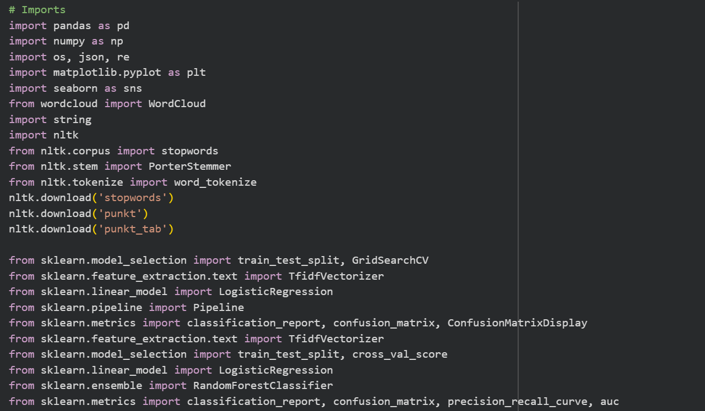
Libraries Used:

Slide 4
1. Research Question / Problem Statement
The Central Question:
How and when were Fourier-transform–based methods (e.g., X-ray crystallography) used in the COVID-19 literature to determine the SARS-CoV-2 spike protein’s structure and function?

Slide 5
- Dr. Fauci
The worst potential bio-terrorist is nature itself. ”
Why This Matters:
Identifying the "textual footprint" of these structural-biology methods shows how physical/math techniques contributed to biological discovery during the pandemic.
Helps researchers and historians quickly find method-specific studies, accelerating future research.

Slide 6
My Hypothesis:
Papers discussing spike-protein structure using Fourier/X-ray methods use a distinct vocabulary and appear in an identifiable temporal cluster early in the pandemic.

Slide 7
Methodology / Approach (Part 1): Our Toolkit & Data Pipeline
Data Source: CORD-19 csv file
A massive collection of scientific papers on COVID-19.
Starting with the metadata.csv file (~691,000 papers).
Technical Stack:
Python for data wrangling and analysis.
Libraries: Pandas, Scikit-learn, NLTK, Matplotlib/Seaborn.
NLP & Machine Learning for text classification.
Data Processing Pipeline:
Load Data: Ingested the CORD-19 metadata.
Filter & Label:
Isolated papers mentioning "spike protein".
Created a binary label: structural_method = 1 for papers also containing keywords like "fourier", "x-ray crystallography", "diffraction", "electron density".
Exploratory Data Analysis (EDA): Analyzed data distribution and missing values.

Slide 8

Methodology / Approach (Part 2)
Building the Classifier
Train an NLP model to automatically identify "structural method" papers based on their text.
The Plan:
Feature Engineering: Use Tf-idf Vectorizer to convert paper abstracts and titles into a numerical matrix based on word importance (Equation above).
Model Training: Implement and compare classifiers:
Logistic Regression (interpretable, good baseline)
Random Forest (robust, handles non-linearity)
Evaluation: Assess model performance using standard metrics: Precision & Recall (Target: >0.75), and Confusion Matrix

Slide 9

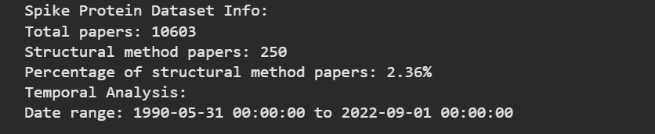
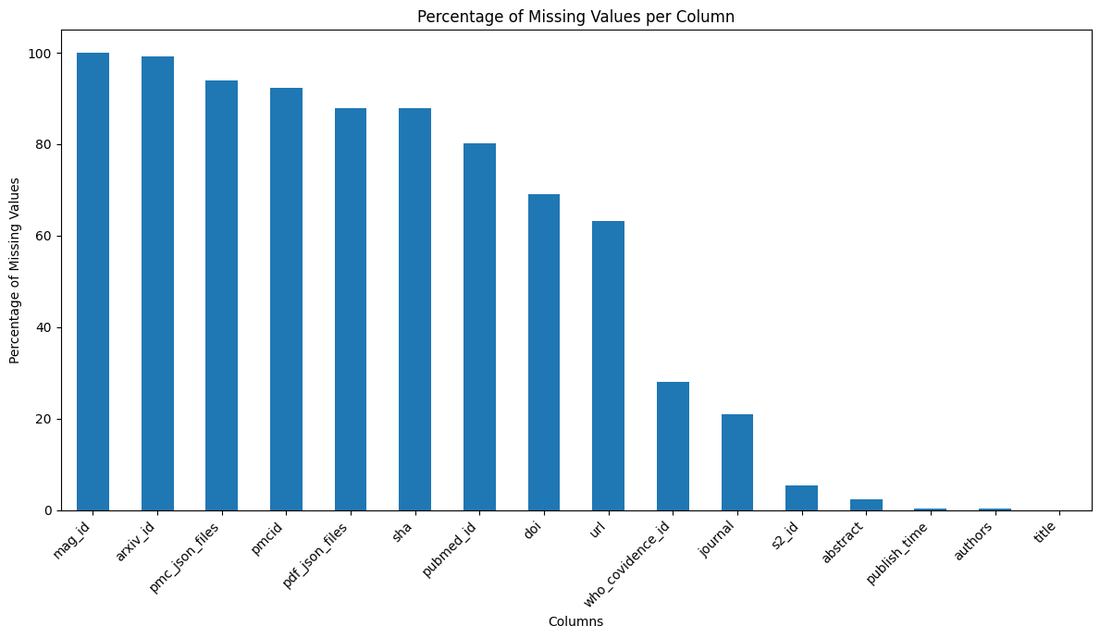
Current Findings / Results (Part 1):
Data Overview:
  Total CORD-19 Papers: ~691,000
  Spike Protein-Related Papers: 10,603
  "Structural Method" Papers (Our Target Class): 250
This is a highly imbalanced dataset, which is a key challenge.
Initial EDA - Missing Data:
  (Visualization here: Bar chart from the notebook showing missing data percentages)
  Critical columns like publish_time have very few missing values (<1%), enabling reliable temporal analysis.
  Full-text JSON paths are often missing, so I relied on abstracts and titles for this phase.

Slide 10
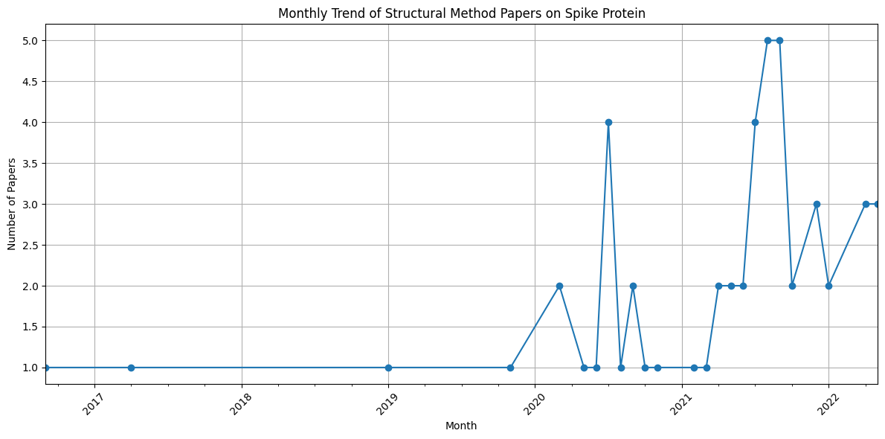
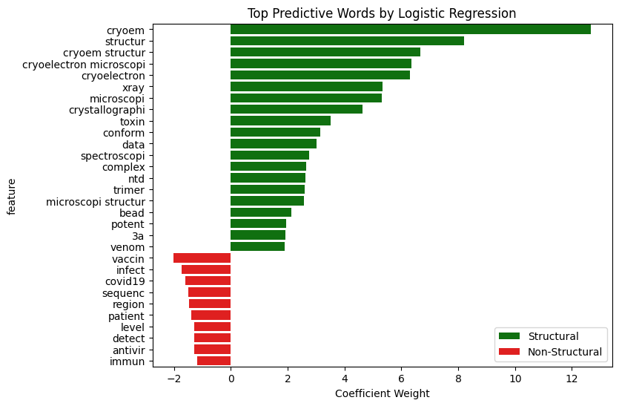
Current Findings / Results (Part 2):
Temporal Cluster Hypothesis:
  *(Visualization: A simple line chart showing the count of structural_method papers per month in 2020-2021)*
  Finding: A clear cluster of structural method papers appeared in early 2020, coinciding with the initial race to solve the spike protein structure.
  This supports the first part of our hypothesis.
Distinct Vocabulary:
  (Visualization: A word cloud generated from the abstracts of the 250 structural_method papers)
  Finding: The model is already identifying highly relevant terms like "resolution", "density", "crystal", and "cryo-em".
  This provides initial evidence for the "distinct vocabulary" part of our hypothesis.

Slide 11
Challenges Encountered
Class Imbalance:
  Problem: Only 250 positive examples vs. ~10,353 negative ones (a 2.4% minority class). This can bias models towards predicting the majority class.
  Mitigation: Used techniques like SMOTE (Synthetic Minority Over-sampling Technique) or class weights in scikit-learn.
Text Preprocessing Complexity:
  Problem: Scientific text contains complex terminology, abbreviations, and symbols that require careful cleaning and normalization.
  Mitigation: Leveraged NLTK for stopword removal and tokenization, tailored for scientific corpus.

Slide 12
Conclusion & Future Directions
Summary of Insights:
We successfully built a filtered dataset from CORD-19 and created a labeled subset for our classification task.
Initial EDA supports our hypothesis: structural method papers have a unique textual signature and emerged as a temporal cluster early in the pandemic.
The foundation for a performant NLP classifier is in place.
Immediate Next Steps (Before Final):
Complete Model Training: Run the Logistic Regression and Random Forest models on the prepared TF-IDF features.
Tackle Class Imbalance: Implement and evaluate strategies (SMOTE, class weights) to improve model recall on the minority class.
Hyperparameter Tuning: Use GridSearchCV to optimize model performance and aim for our target Precision/Recall > 0.75.
Longer-Term Vision:
Incorporate any available full-text data for a deeper analysis.
Perform a more sophisticated temporal trend analysis.
Implement early stopping within BERT model, which stops training when the validation performance stops improving.
Deploy the final model as a tool for literature discovery.

Slide 13
Thanks!
Any questions?
You can find me at
920146978@student.ccga.edu

Slide 14
Credits
Special thanks to all the people who made and released these awesome resources for free:
Kaggle Dataset here
Presentation template by SlidesCarnival
Photographs by Unsplash
COVID-19 virus image from CDC by Alissa Eckert & Dan Higgins · Public domain and thus free of any copyright restrictions

